Slide 1
Sprint Goals/Accomplishments
My goal this sprint was to finish up the user profile creation for the main menu and to create some assets for the HUD.
I committed about 6 hours to this task.
Results:
I worked about 5 hours this week on this task.
I had a major setback on the user profile creation which will result in rewriting a large section of code.
The HUD assets are finished and mapped out.

Slide 2
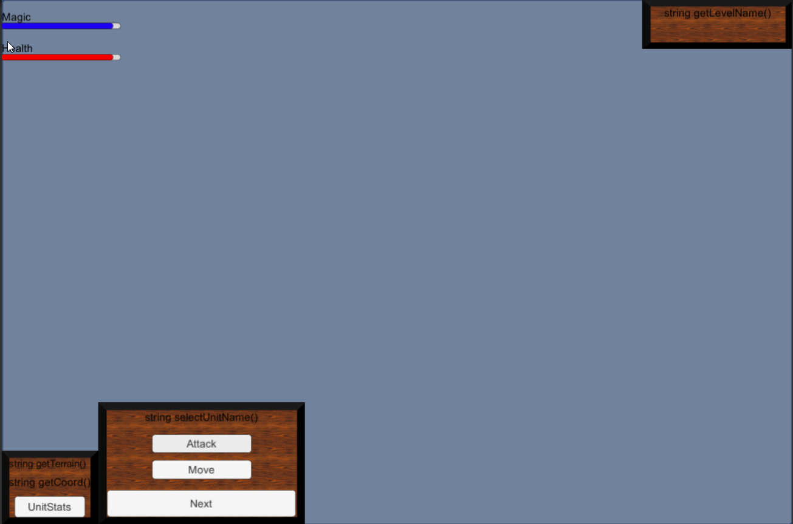
In-Game HUD Display

